Slide 1

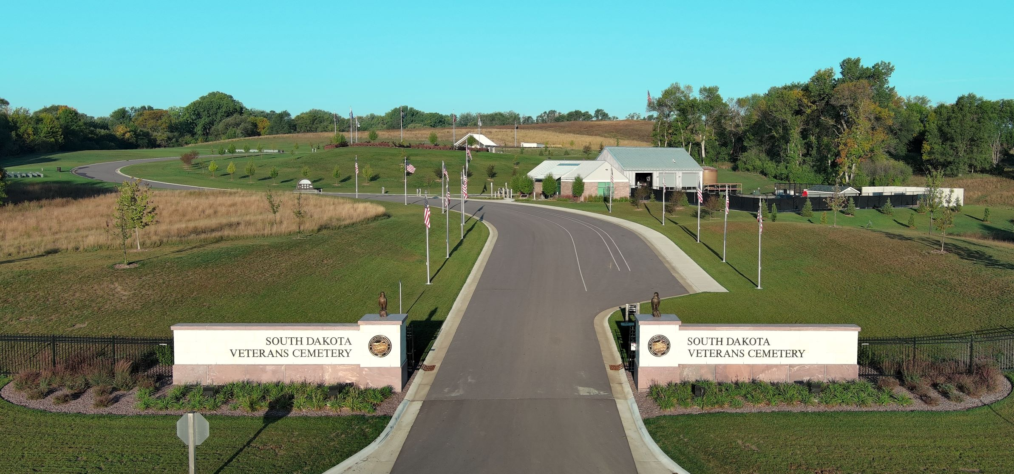
South Dakota Veterans Cemetery

Slide 2
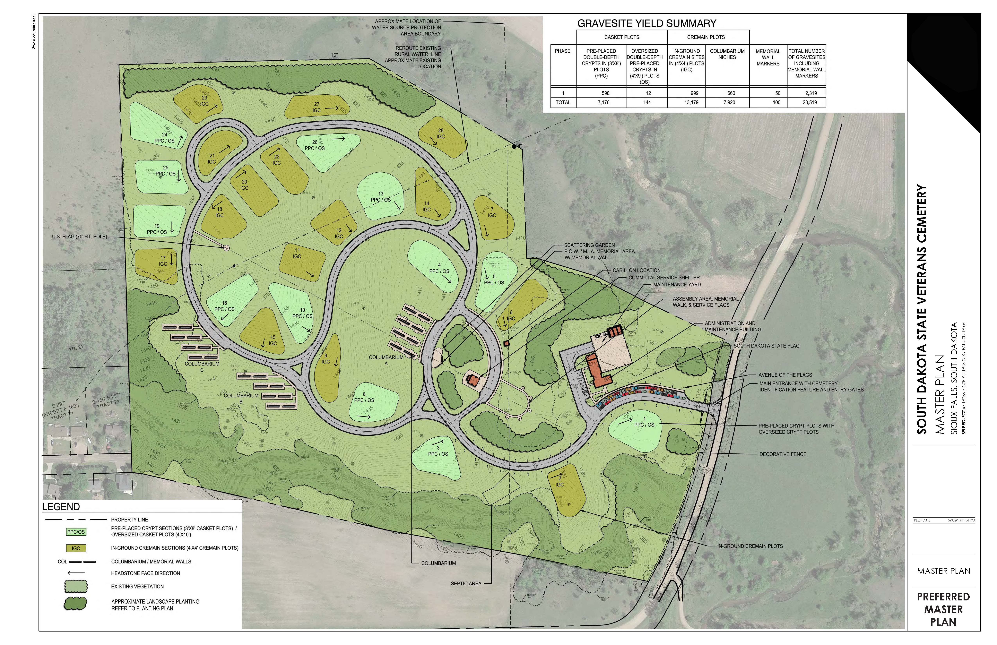
Master Plan for Complete Build Out
Notes:
Cemetery Master Plan for full build out – City of Sioux Falls donated 60 acres of land.
We conducted our first burial in June 2021

Slide 3
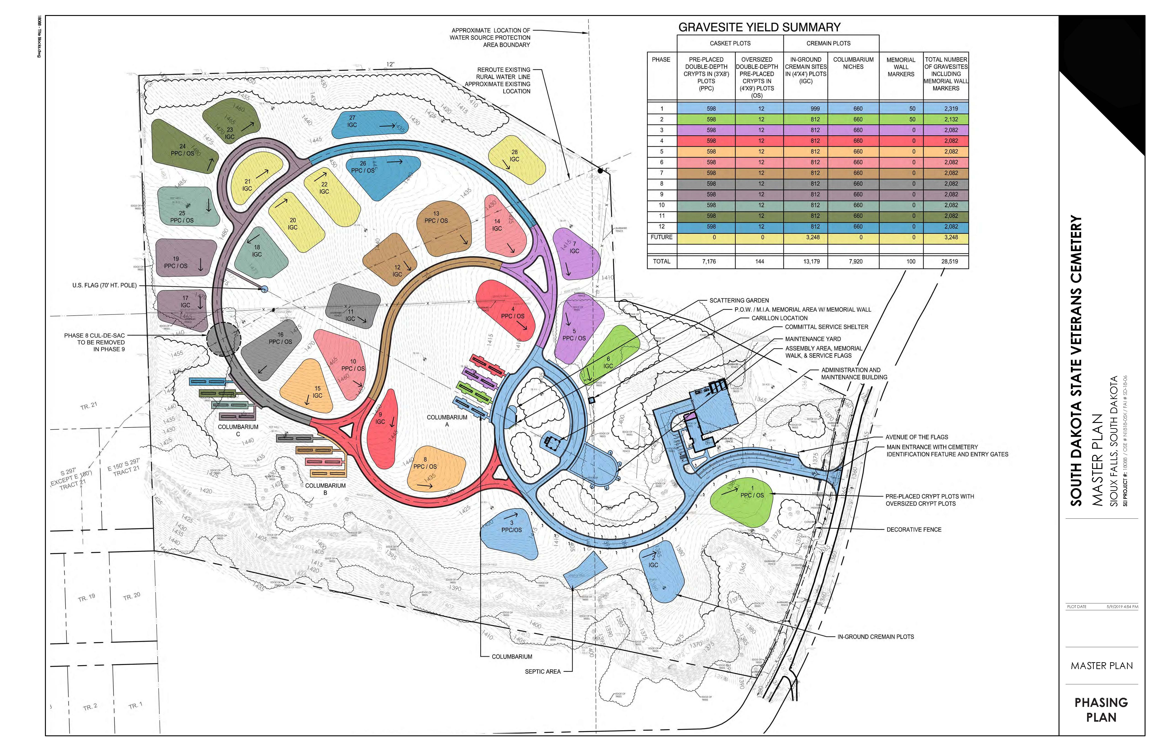
Phasing Plan
Notes:
Cemetery Phasing Plan

Slide 4
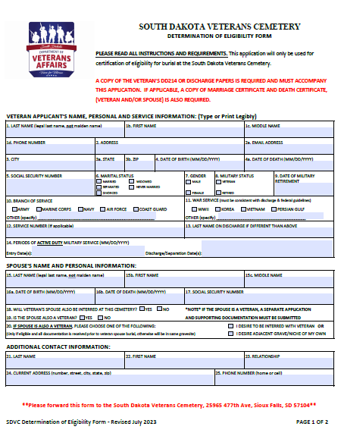
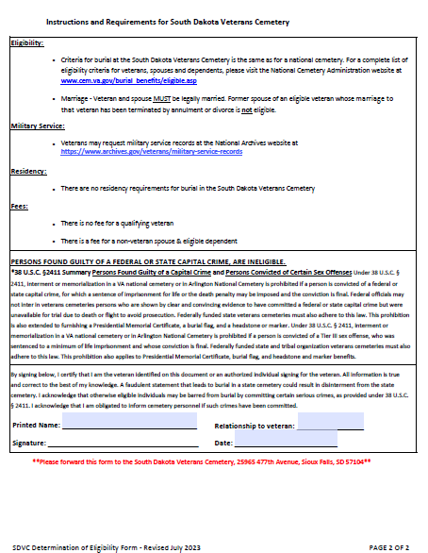
Determination of Eligibility
While visiting the SDDVA website under Veterans Cemetery, you will find a link to the determination of eligibility form.
Complete this form, attach the necessary documents (discharge papers, marriage certificate, etc.) and submit to the Cemetery.

Slide 5
Determination of Eligibility
Supporting documentation to determine eligibility:
DD214 or equivalent discharge document(s)
20-year retirement letter
VA service connection letter
Marriage certificate (if applicable)
Notes:
Don’t forget to include these documents with the application.
Make sure you have the most recent application with the address to the cemetery on it!
If approved or additional information is needed, a letter will be mailed to the applicant.

Slide 6
Who Is Eligible?
Veterans and Members of the Armed Forces (Army, Navy, Air Force, Marine Corps, Coast Guard)
(1) Any member of the Armed Forces of the United States who dies on active duty.
(2) Any Veteran who was discharged under conditions other than dishonorable. With certain exceptions, service beginning after September 7, 1980, as an enlisted person, and service after October 16, 1981, as an officer, must be for a minimum of 24 continuous months or the full period for which the person was called to active duty (as in the case of a Reservist called to active duty for a limited duration). Undesirable, bad conduct, and any other type of discharge other than honorable may or may not qualify the individual for Veterans benefits, depending upon a determination made by a VA Regional Office. Cases presenting multiple discharges of varying character are also referred for adjudication to a VA Regional Office.
(3) Any citizen of the United States who, during any war in which the United States has or may be engaged, served in the Armed Forces of any Government allied with the United States during that war, whose last active service was terminated honorably by death or otherwise, and who was a citizen of the United States at the time of entry into such service and at the time of death.
Notes:
Of course, I’m not going to read this to you….
What it says…any service time before 1980
Wait there’s more…..

Slide 7
Who Is Eligible?
Members of Reserve Components and Reserve Officers’ Training Corps
(1) Reservists and National Guard members who, at time of death, were entitled to retired pay under Chapter 1223, title 10, United States Code, or would have been entitled, but for being under the age of 60. Specific categories of individuals eligible for retired pay are delineated in section 12731 of Chapter 1223, title 10, United States Code.
(2) Members of reserve components, and members of the Army National Guard or the Air National Guard, who die while hospitalized or undergoing treatment at the expense of the United States for injury or disease contracted or incurred under honorable conditions while performing active duty for training or inactive duty training, or undergoing such hospitalization or treatment.
(3) Members of the Reserve Officers’ Training Corps of the Army, Navy, or Air Force who die under honorable conditions while attending an authorized training camp or on an authorized cruise, while performing authorized travel to or from that camp or cruise, or while hospitalized or undergoing treatment at the expense of the United States for injury or disease contracted or incurred under honorable conditions while engaged in one of those activities.
(4) Members of reserve components who, during a period of active duty for training, were disabled or died from a disease or injury incurred or aggravated in line of duty or, during a period of inactive duty training, were disabled or died from an injury or certain cardiovascular disorders incurred or aggravated in line of duty.
(5) Members of reserve and Guard components who have met minimum active duty service requirements, as applicable by law, and who were discharged under conditions other than dishonorable are also eligible provided they were called to active duty and served the full term of service.
Notes:
Of course, I’m not going to read this to you….

Slide 8
Burial Process
Once the veteran or eligible dependent passes away what happens?
Schedule Burial
Complete the following forms:
  Burial Application
  Headstone/Niche Monument Data Form
  Release for Funeral Honors (if applicable)

Slide 9
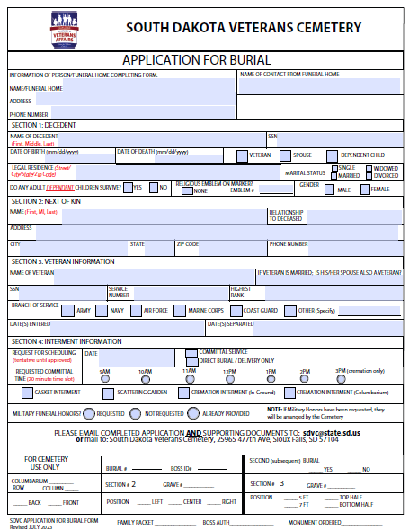
Burial Process
Burial Application

Slide 10
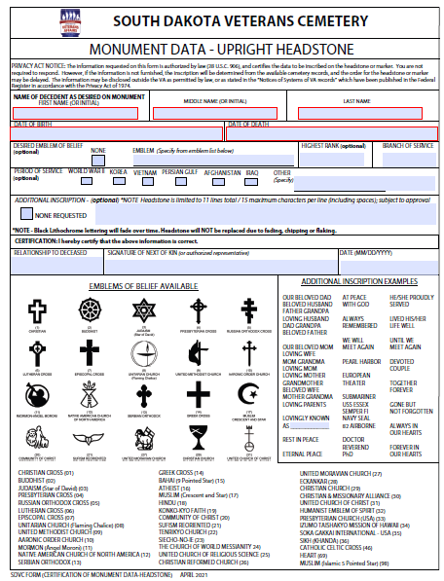
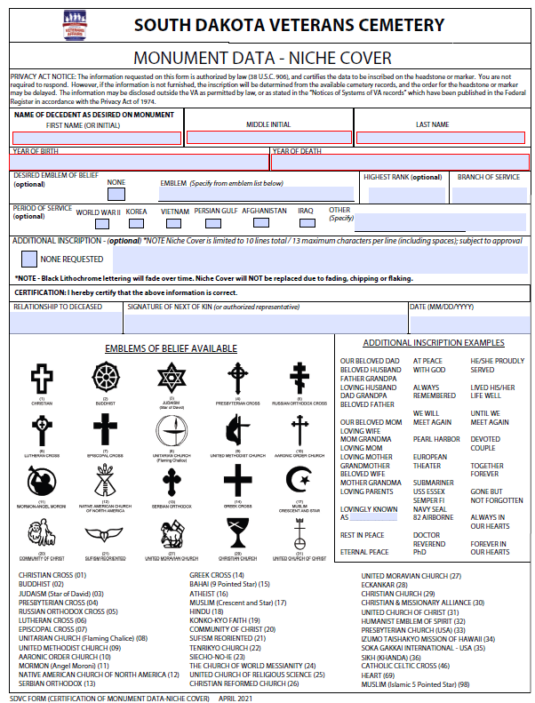
Burial Process
Notes:
How many lines/what is optional/what has to go on there
Upright Granite----4in thick…

Slide 11
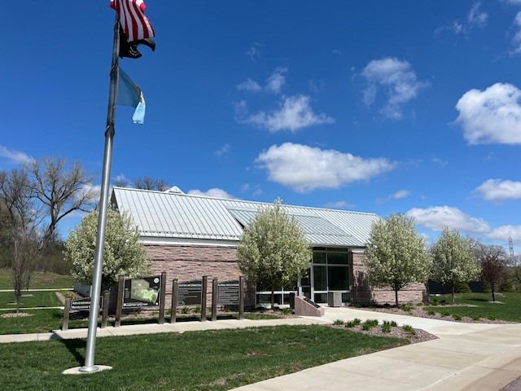
Day of Service
Family arrives 15 minutes before their scheduled service time
We review, with the family, the headstone/niche layout for approval
Procession of vehicles proceeds to the committal shelter for service

Slide 12
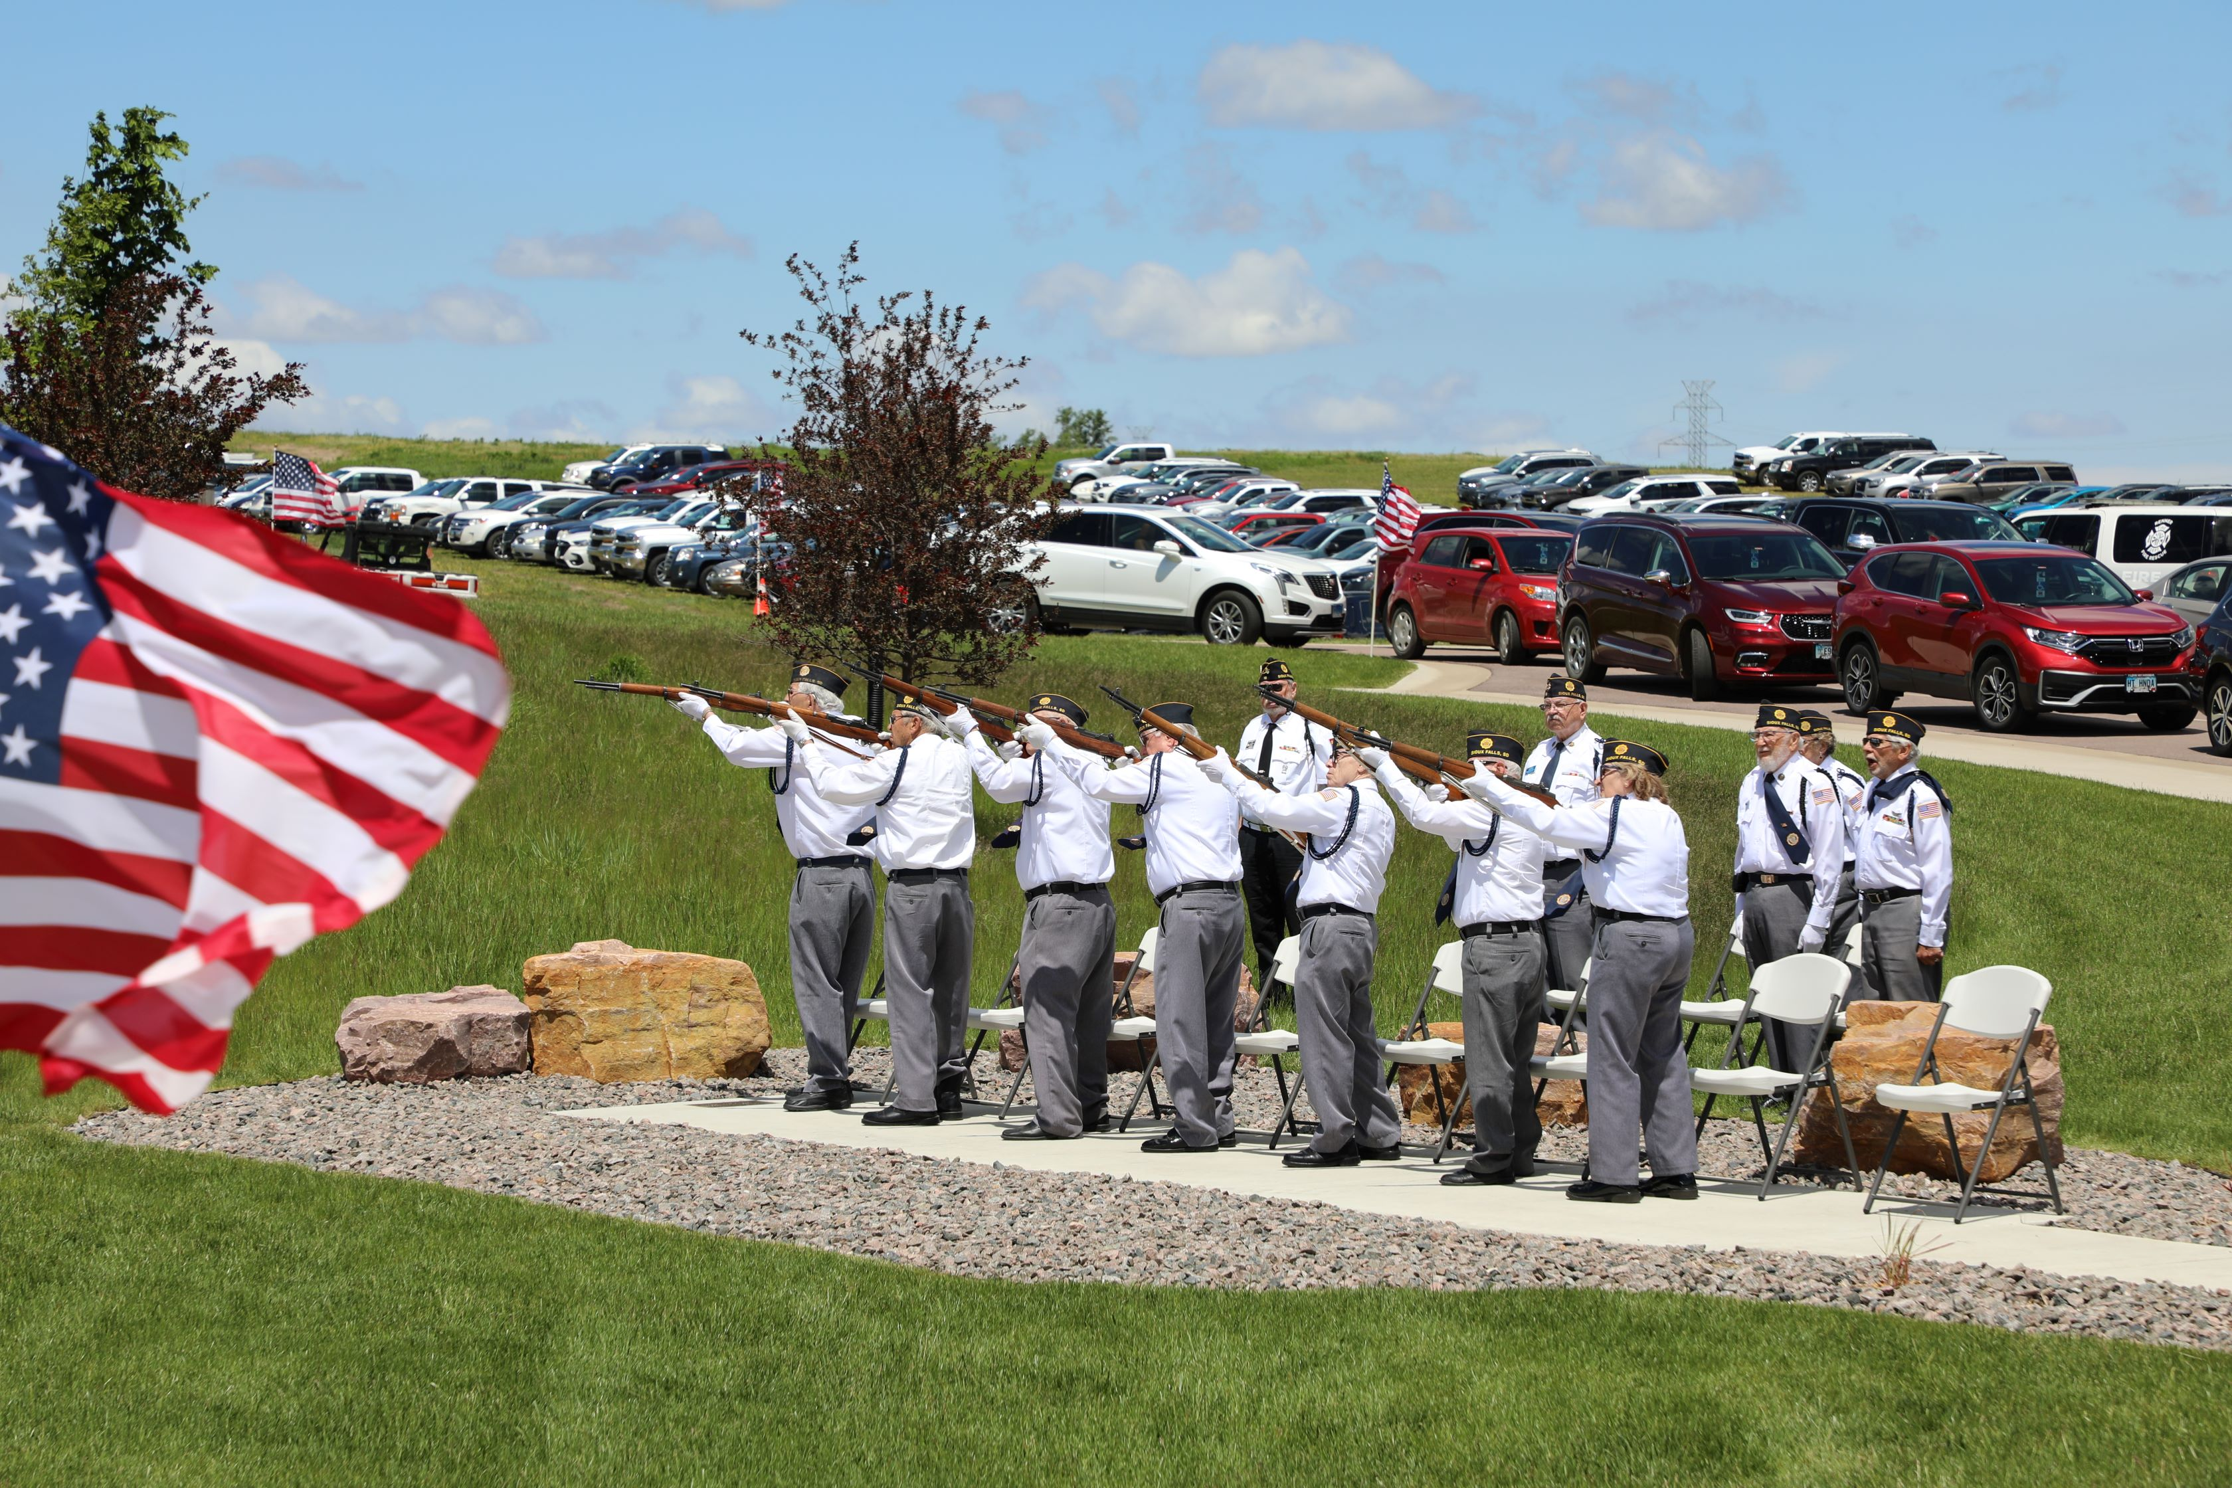

Day of Service
Folding and presentation of the flag performed by Active Duty Component
Rifle Volley and Taps performed by the local Service Organizations
Notes:
AD performs all honors for a retiree
Burial – following slides are burial sections

Slide 13
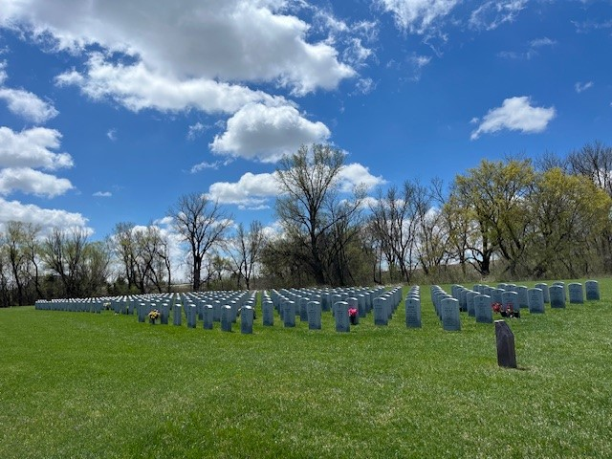
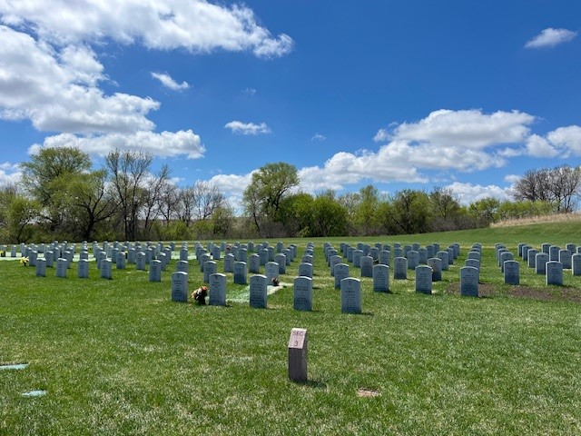
Section 2 & Section 3

Slide 14
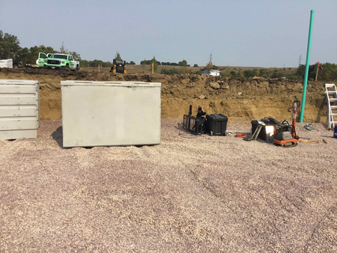
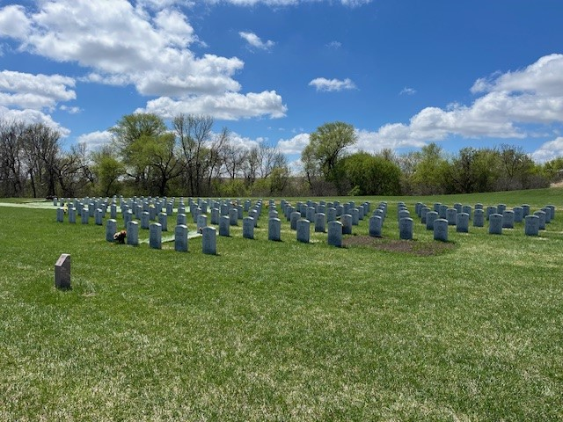
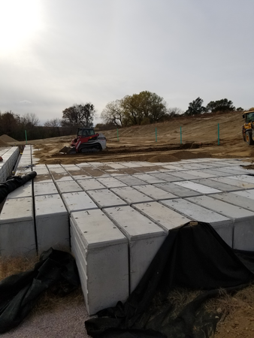
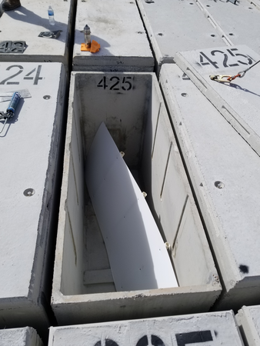
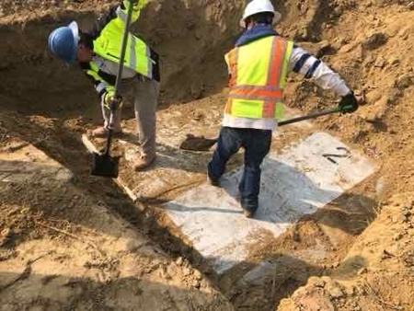
Pre-Placed Crypts

Slide 15
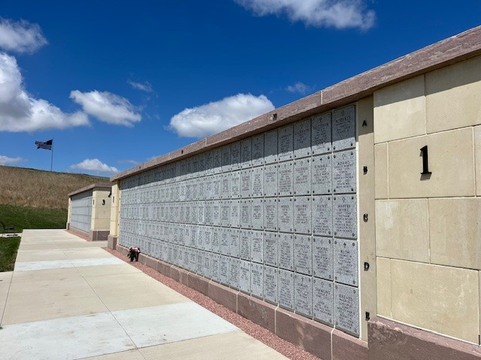
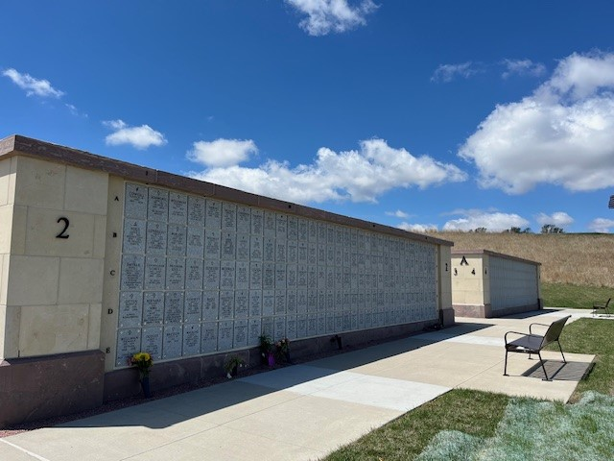
Columbarium

Slide 16
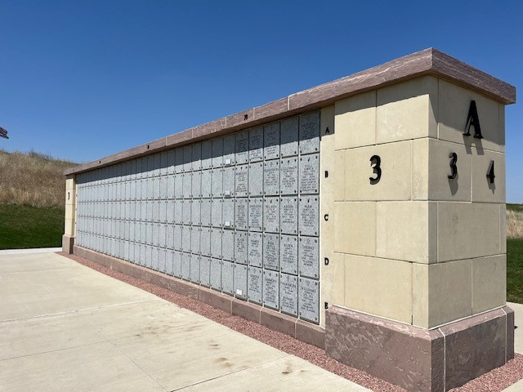
Columbarium

Slide 17
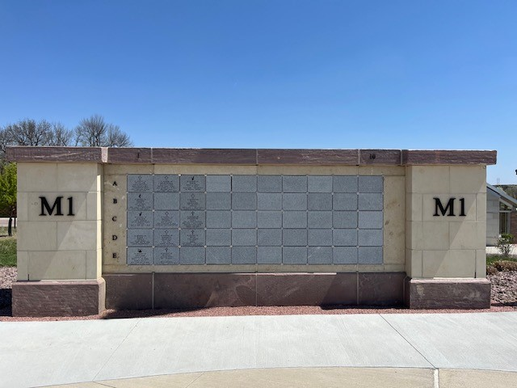
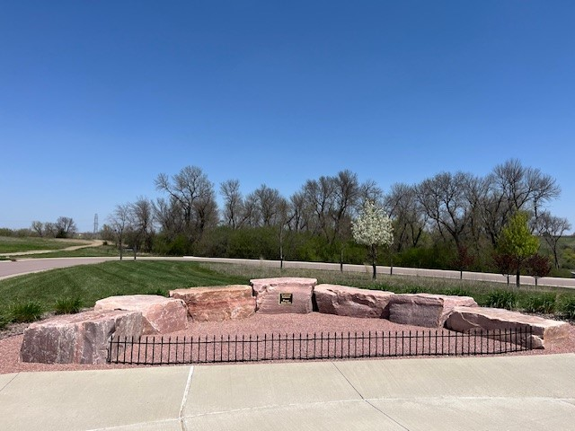
Memorial Wall / Scattering Garden

Slide 18
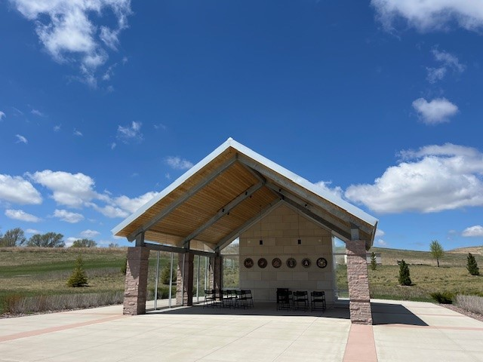
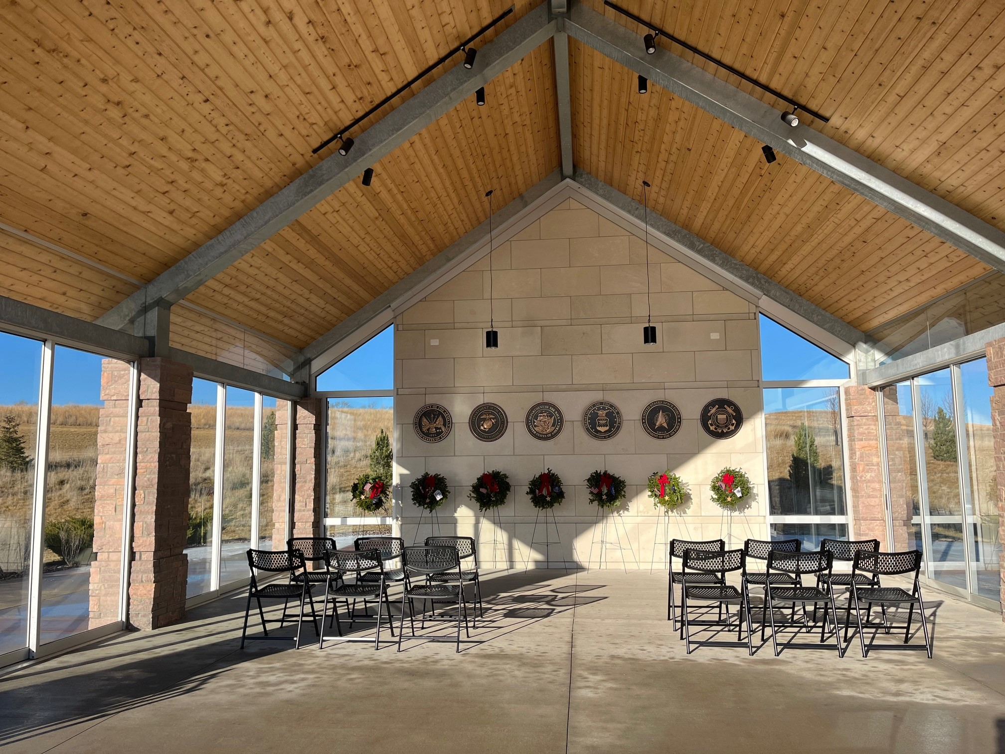
Committal
Shelter

Slide 19


Administration and Maintenance Building

Slide 20


Avenue of Flags

Slide 21
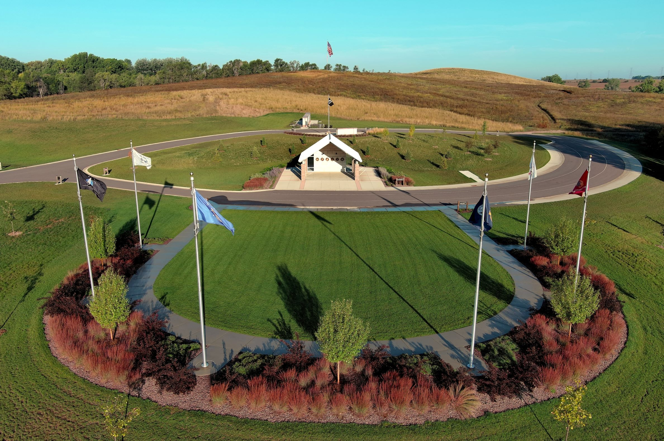
Contact us:
Phone number (605)-277-8094
Email address: sdvc@state.sd.us
Address:
25965 477th Avenue
Sioux Falls, SD 57104
Website: stateveteranscemetery.sd.gov

